Slide 1
CarbonAware
Dinesh-2221935​
Ramesh-2108249​

Slide 2
Table of contents
01
02
03
04
Conceive
Solution
Application
Design

Slide 3
Conceive

Slide 4
Problem Statement
Existing carbon footprint calculation tools are not tailored to the unique lifestyle and environmental considerations of residents in Singapore.
Most Singaporeans live in apartments, rely on public transportation, and have limited usage of heaters due to the tropical climate.
This leads to inaccuracies in carbon footprint assessments and hinders the ability to provide personalized recommendations for sustainable living in Singapore.

Slide 5
Background Information
Climate Change and Individual Contributions:
Singapore's Unique Context:
Importance of Tailored Solutions:
Climate change is a global challenge driven by increasing greenhouse gas emissions.
Individuals significantly contribute to these emissions through their daily activities.
Singapore has a high population density, with most residents living in apartments and relying on public transportation.
The tropical climate reduces the need for heaters and presents unique considerations for energy consumption.
A specialized carbon footprint calculator and tracker are essential for addressing Singapore's specific challenges.
By providing a customized solution, individuals can accurately measure, understand, and reduce their carbon footprints.

Slide 6
Research into existing solutions
Carbon Footprint Calculators:
Sustainable Lifestyle Apps:
WWF Footprint Calculator: Measures carbon footprint based on lifestyle choices including energy consumption, transportation, diet, and waste.
Carbon Footprint Ltd: Offers calculators for individuals, households, and businesses, considering factors such as energy use, travel, and waste generation.
JouleBug: Gamifies sustainable living, encouraging users to take eco-friendly actions and reduce their carbon footprint through challenges, social sharing, and education.
Oroeco: Tracks carbon footprints based on users' spending habits, connecting to financial accounts to estimate emissions associated with consumption.

Slide 7
Research into existing solutions
Country-Specific Tools
Corporate Sustainability Platforms:
Singapore Green Plan 2030: Government-led initiative with strategies and programs to achieve sustainability goals in Singapore, including tools for carbon footprint reduction, energy efficiency, and cleaner transportation.
Carbon Footprint Management Systems: Used by businesses and organizations to measure and track emissions, providing tools for data collection, analysis, and reporting to support sustainability efforts.
SP Group's Carbon Footprint Tracking Website:
SP Group, Singapore's leading energy utilities company, offers a website to track personal carbon footprints. Visit their website for personalized carbon footprint information and insights. (Add the URL of SP Group's website here)

Slide 8
Solution
Develop a specialized app for residents in Singapore to calculate and track their carbon footprints accurately.
Customize the app to account for Singapore's unique lifestyle and environmental considerations, including apartment living, public transportation usage, and minimal heater usage.

Slide 9
What is CarbonAware about?
Comprehensive Data Input:
Enable users to input data related to their daily activities, including transportation choices, meal preferences, and household items.
Incorporate relevant data points such as energy consumption, waste generation, and travel habits to provide comprehensive carbon footprint calculations.
Personalized Recommendations and Statistics:
Offer personalized recommendations for reducing carbon footprints based on users' specific data and patterns.
Provide relevant statistics and insights to empower users with knowledge and encourage sustainable lifestyle changes.
Tracking
Enable users to track their carbon footprints over time, allowing them to monitor progress

Slide 10
Pros and Cons of proposed solution
Pros:
Environmental Awareness: The app raises awareness about sustainable living and users' individual impact on the environment, fostering a sense of responsibility.
Personalized Insights: By logging activities and calculating carbon footprints, users gain personalized insights into their environmental impact, enabling informed decision-making.
Cons:
User Adoption: Encouraging users to download and use the app requires effective marketing strategies and user engagement techniques to attract and retain a significant user base.
Data Accuracy: The accuracy of carbon footprint calculations depends on user input and available data, which can be influenced by variations in user behavior and inconsistent input.

Slide 11
Application Specification

Slide 12
Design

Slide 13
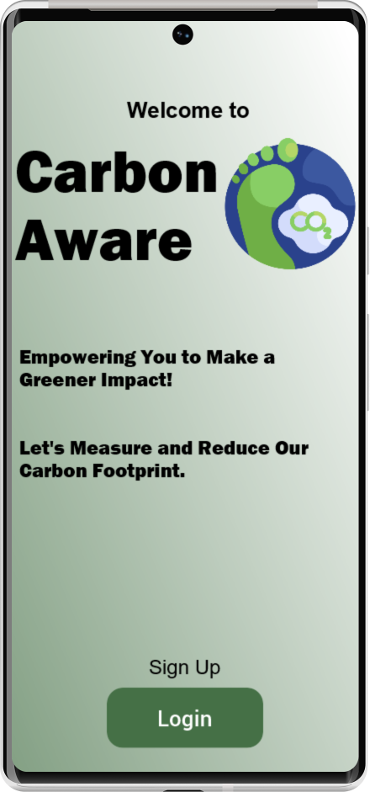
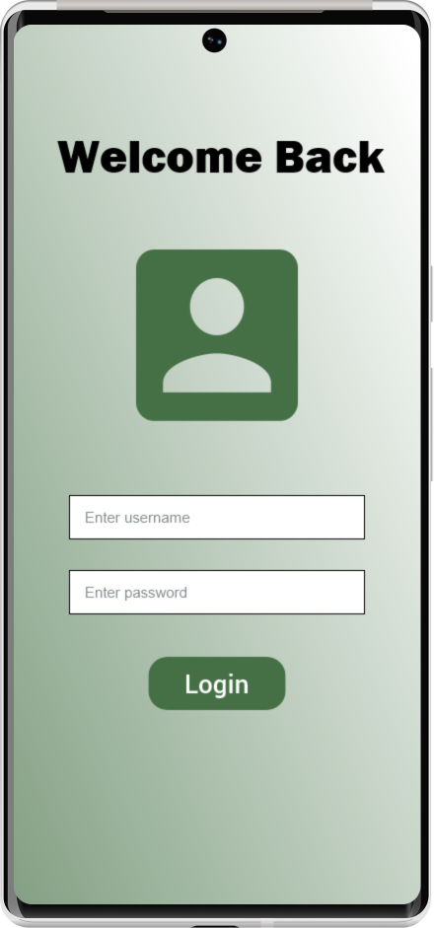
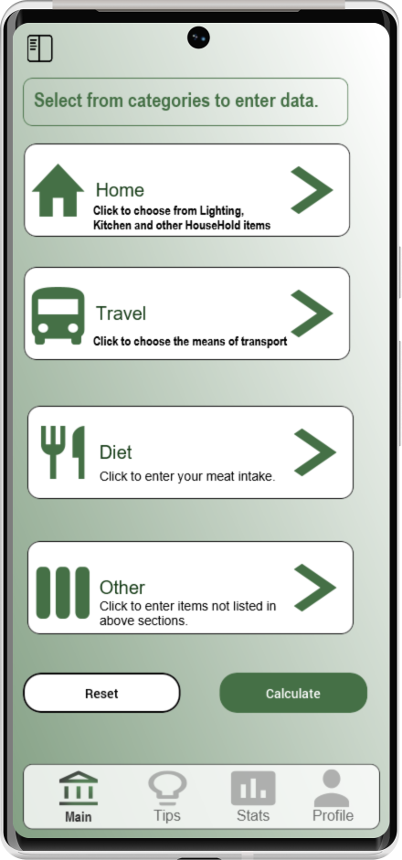
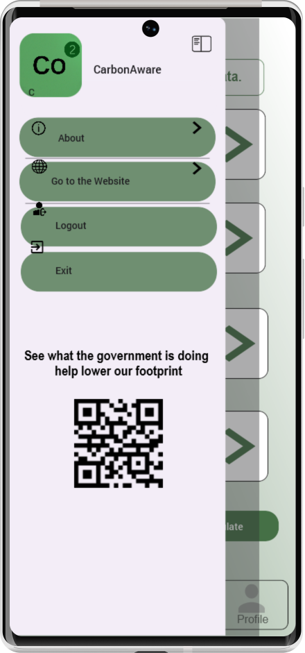
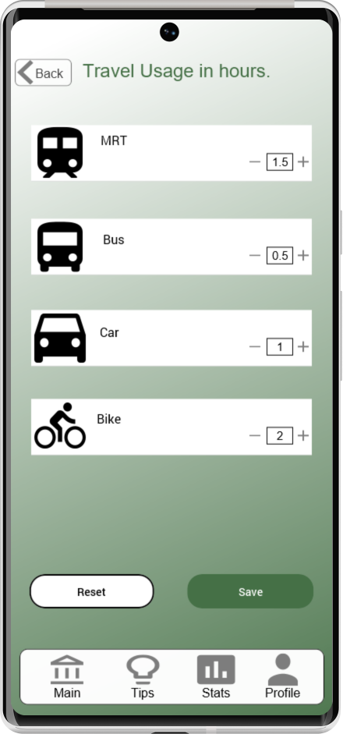
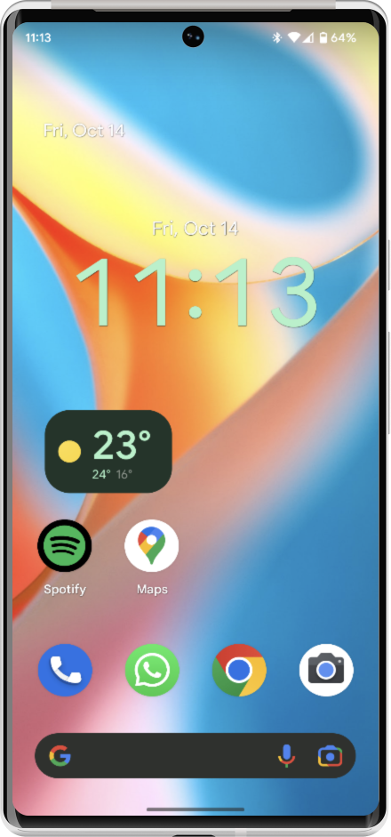
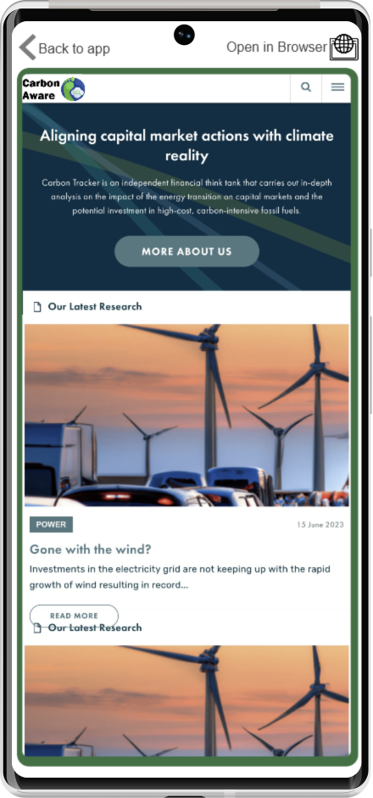
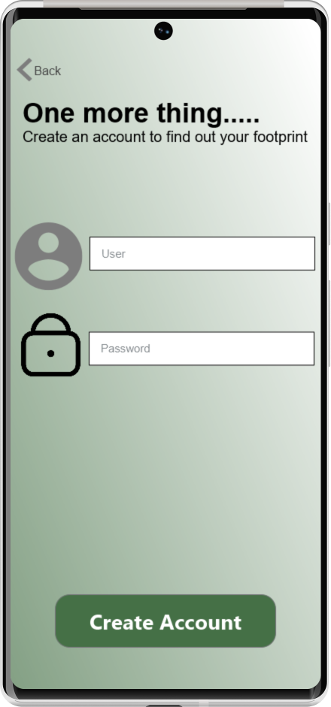
Overall GUI flow
Home Page
Nav Drawer
About Page
Login
Sign Up
Exit
Website
Login

Slide 14
Notes
By verifying the database, Login Page will alert users when their username or password is incorrect.
By signing up, a new record will be added to the database.
The Navigation Drawer in CarbonAware enables easy access to different app sections and features, enhancing user navigation and interaction.
The QR code scanner will give quick access to Singapore's carbon emission reduction efforts.
The About Page in CarbonAware provides key details about the app, including its purpose, app logo, and version number.
These sections provide users with valuable information, guidance, and tools to track, manage, and improve their carbon footprint and overall sustainability efforts

Slide 15
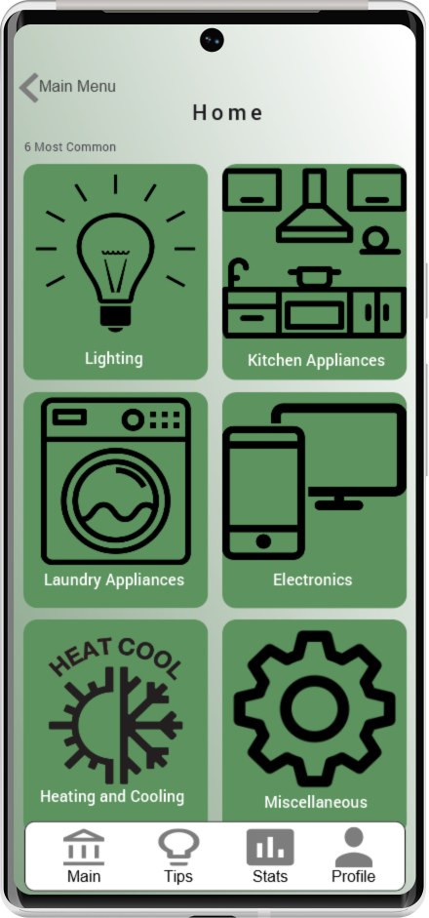
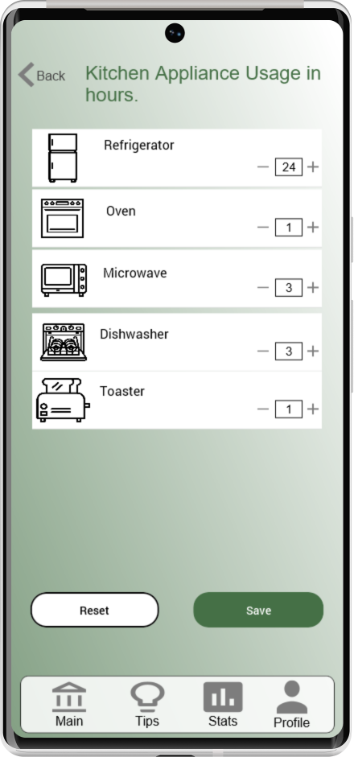
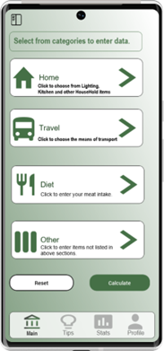
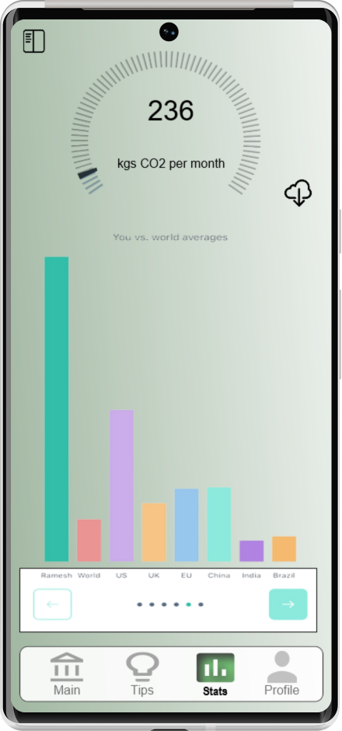
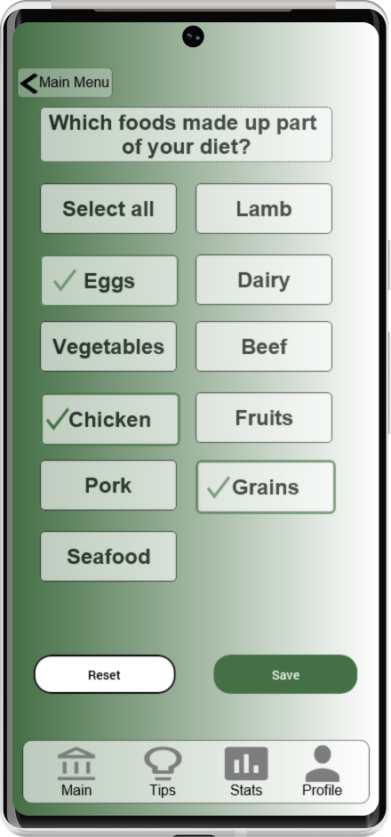
Overall GUI flow
Kitchen Appliances
Home
Save
Calculate
Save
Diet
Save
Travel

Slide 16
Notes
Travel: Log hours spent on different transportation modes to monitor and understand your carbon footprint. Tap "Save" to go back to home page.
Home Utility: Track hours of electricity, gas, or water usage to identify areas for improvement. Tap "Save" to go back to home page.
Diet: Record time spent on different dietary choices to understand your environmental impact. Tap "Save" to go back to home page.
Others: Log hours spent on various activities to gain insights into your carbon footprint. Tap "Save" to go back to home page.
The “Calculate" button allows users to calculate their carbon footprint based on the logged hours, enabling them to make informed decisions and take steps towards reducing their environmental impact.

Slide 17
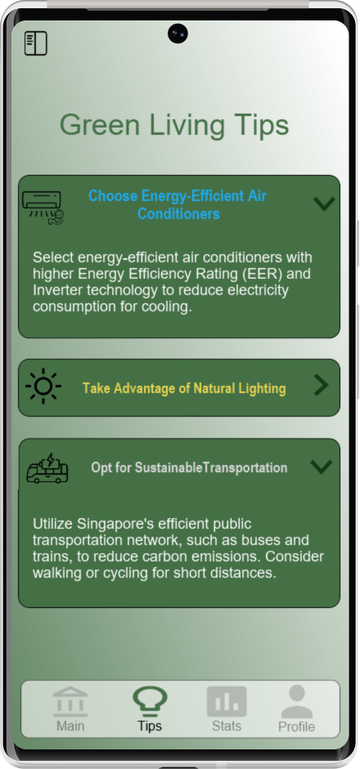
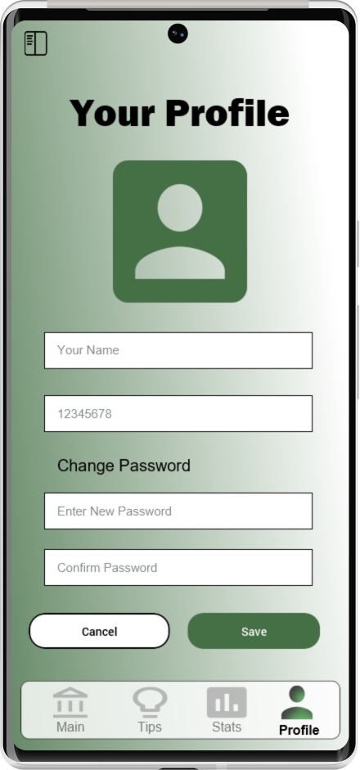
Overall GUI flow
Home Page
Stats Page
Profile Page
Tips Pages

Slide 18
Notes
The home page, with its bottom navigation bar, serves as the main dashboard of the CarbonAware app, offering easy access to essential features and information. Its purposes are:
Tips: Personalized recommendations and actionable tips for reducing carbon footprint.
Home: Choices to choose from when entering data for each category
Stats: Detailed insights and visualizations of carbon footprint data over time.
Profile: Manage personal information, settings, preferences, sustainability goals, and achievements.

Slide 19
Contribution
Dinesh:
Welcome screen(UI)
Login functionality(Database and UI)
Home utility section(UI)
User profile(Database and UI)
Travel page(Database and UI)
About page(UI)
Bottom Navigation Bar(UI)
Ramesh:
Home page(UI)
Diet page(Database and UI)
Tips page(UI)
Stats page(Database and UI)
Navigation drawer(UI)
Website view (UI)
Kitchen Appliances page(Database and UI)

Slide 20
Features used:
Basic Features:
 Use of CardView
 Use of Bottom Navigation Bar
 Using Splash Screen with music or with Text-to-Speech
Advanced Features:
 Using Web View to view web pages within app.
 Cloud Database (e.g., Firebase) for User Login/Authentication:
 Use of Navigation Drawer
 Integration with other module mini-project
 Use of RecyclerView with Item Selection
Self-Direct Learning Features:
 NoSQL Cassandra (AstraDB) Database for User Input and Data Storage:

Slide 21
Thanks!

Slide 22

UI Designer : Justinmind

